Slide 1

David M. Kroenke and David J. Auer Database Processing Fundamentals, Design, and Implementation
Appendix E:
Getting Started with MySQL Workbench Data Modeling Tools

Slide 2
Appendix Objectives
Learn how to install the MySQL OBDC/Connector
Learn how to create database designs in the MySQL Workbench

Slide 3
MySQL Components I
1. MySQL Community Edition. (Formerly MySQL Community Server) Download the current generally available (GA) version for your operating system.
2. MySQL Workbench. The MySQL Workbench has replaced the MySQL GUI Tools (The MySQL Query Browser and MySQL Administrator) as the graphical administration and SQL command utility for MySQL. In addition, it can be used for database design as described in Chapter 6.
3. MySQL Connector/ODBC. This provides the ODBC programs necessary to provide Web application connectivity to a MySQL database as described in Chapter 11.
NOTE. If you are using the Windows operating system, download and use the MySQL Installer for Windows. This includes all of the three components listed above, and provides an easy to use installation interface.

Slide 4
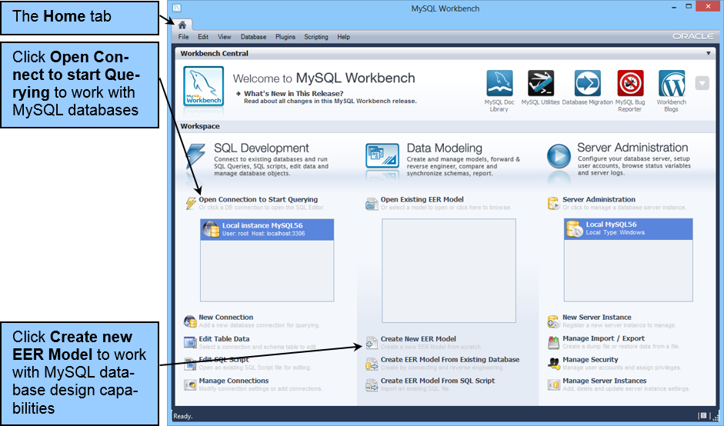
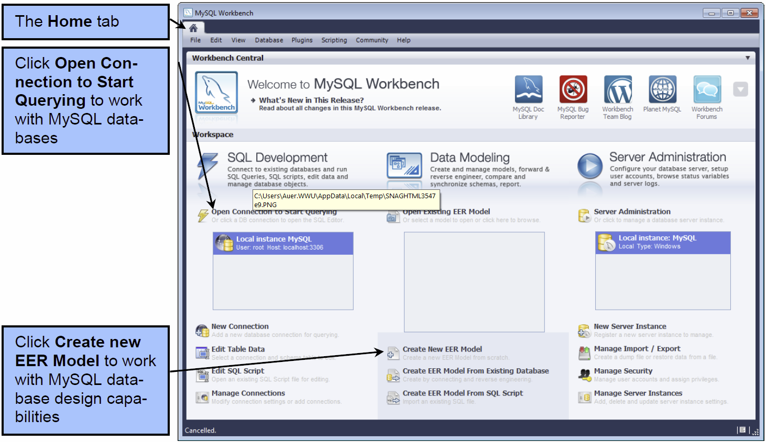
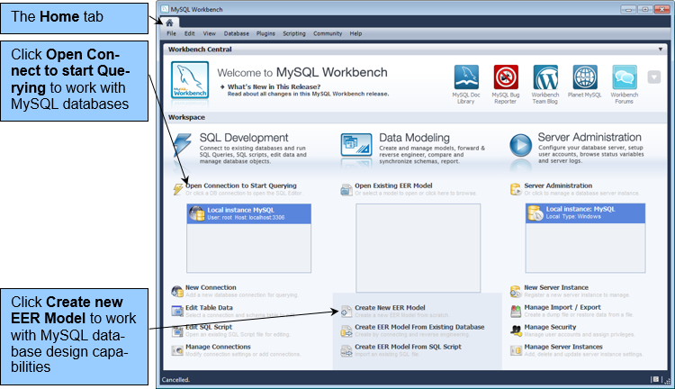
The MySQL Workbench Home Tab

Slide 5
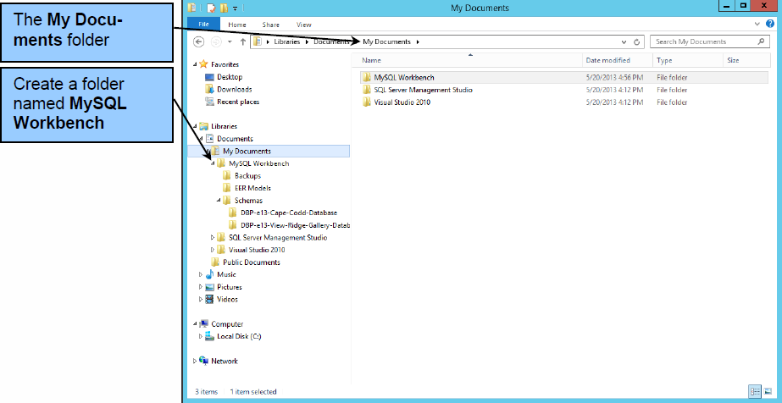
The MySQL-Workspace Folder in Windows Explorer

Slide 6
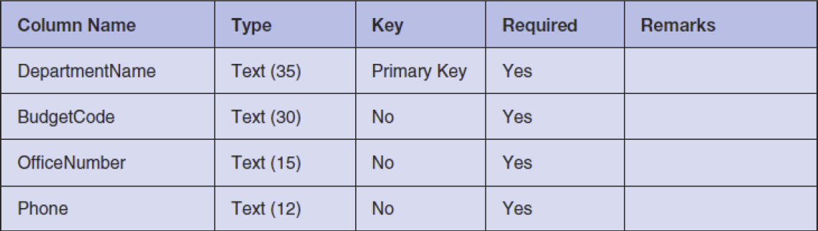
The WPC Database Column Characteristics DEPARTMENT Table

Slide 7
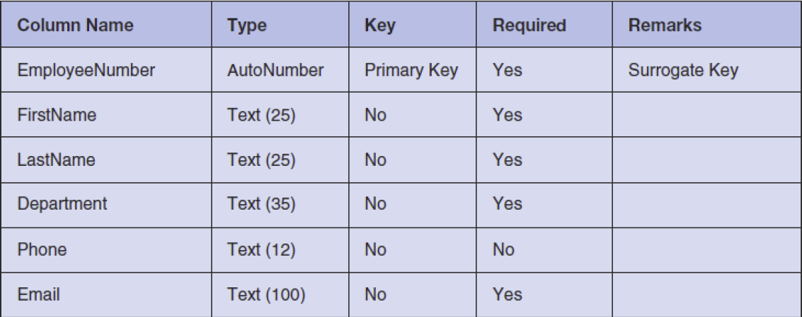
The WPC Database Column Characteristics EMPLOYEE Table

Slide 8
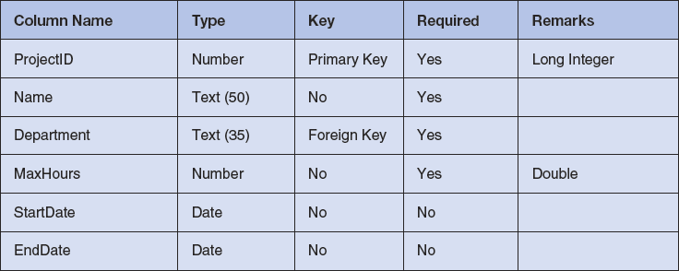
The WPC Database Column Characteristics PROJECT Table

Slide 9
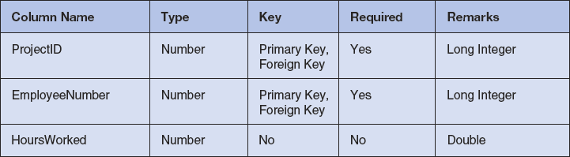
The WPC Database Column Characteristics ASSIGNMENT Table

Slide 10
Creating Database Designs in the MySQL Workbench
To create a new data model in the MySQL Workbench, you can:
Use the File | New Model command, or
Click the Create new EER Model link on the Home page.

Slide 11
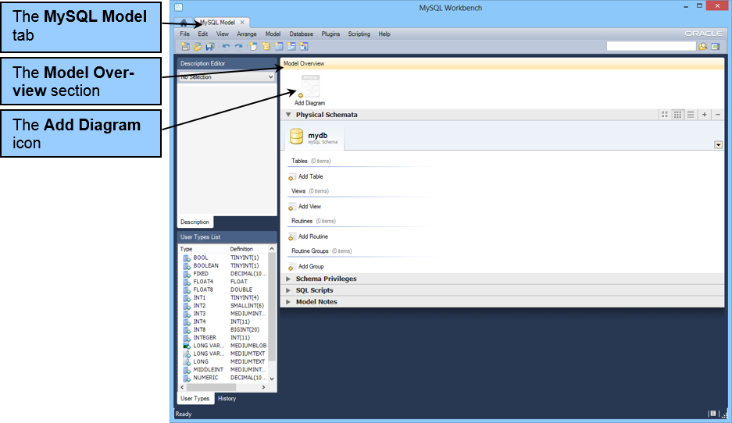
The MySQL Model Tab and Window

Slide 12
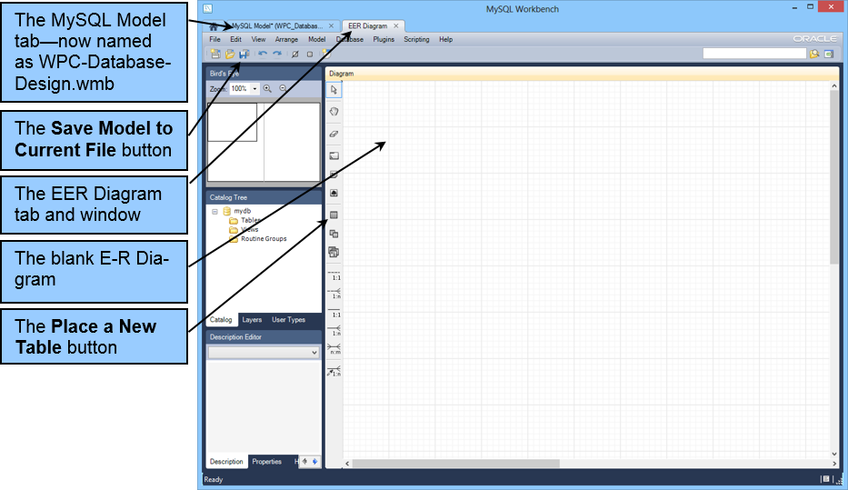
The Blank E-R Diagram

Slide 13
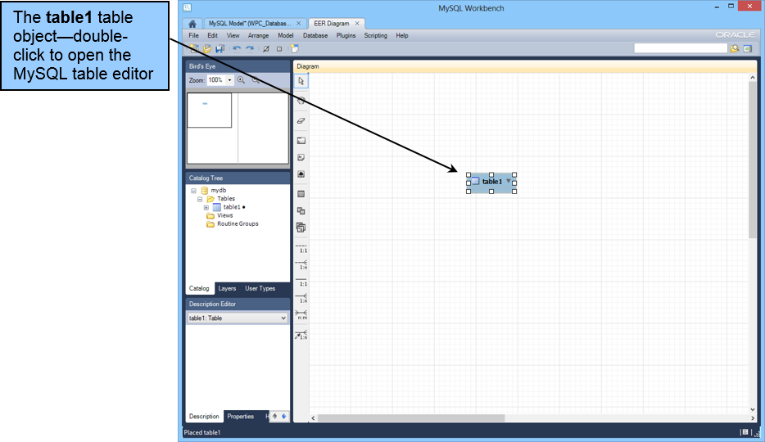
The table1 Table Object

Slide 14
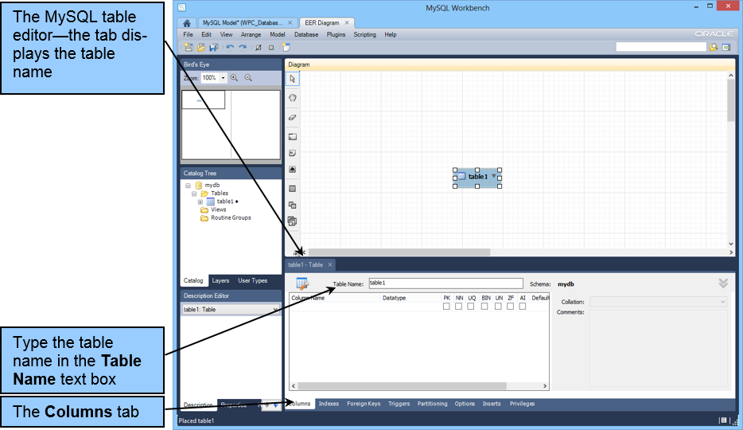
The MySQL Table Editor

Slide 15
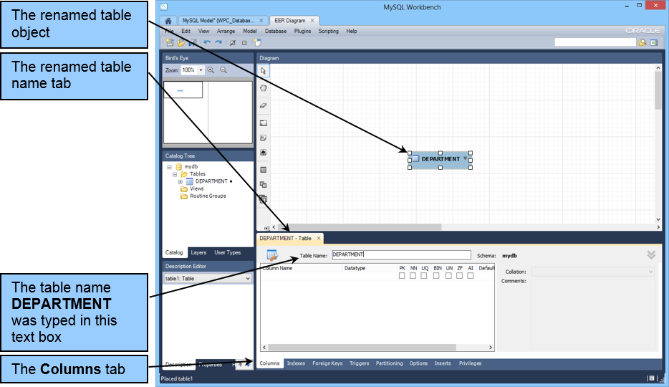
The Renamed Table

Slide 16
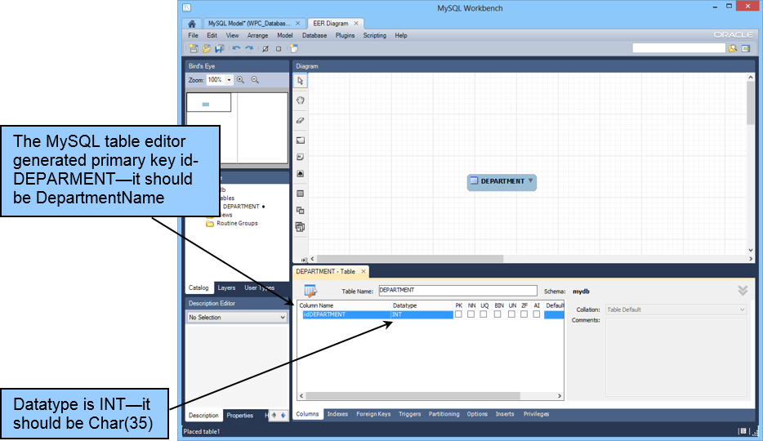
The MySQL Table Editor Generated Primary Key idDEPARTMENT

Slide 17
MySQL Workbench Table Column Checkbox Options
PK Primary Key – Check if this column is the primary key or part of a composite primary key.
NN NOT NULL – Check if this column must have an inserted value.
UQ UNIQUE – Check if this column must contain a unique value.
BIN Binary – Check if this the column uses only two values, such as 0 and 1 or Yes and No.
UN Unsigned Data Type – Check if this column uses numbers without negative values and you specifically want to not permit negative numbers where they might otherwise be allowed. Zero fill (ZF) numbers are automatically checked UN.
ZF Zero Fill – Check if this column should be automatically filled with zeros.
AI AUTO_INCREMENT – Check if this column is a primary key that should have sequential surrogate key values.

Slide 18
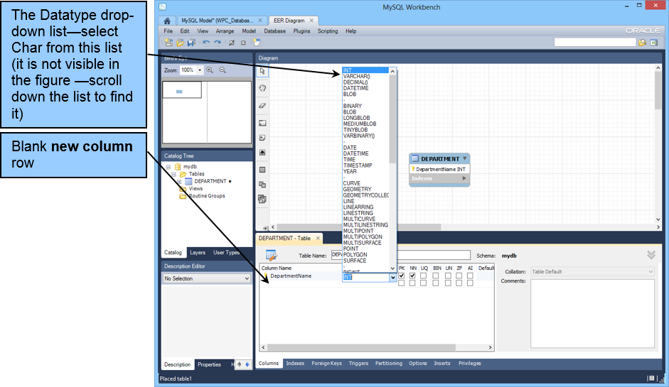
The Datatype Drop-Down List

Slide 19
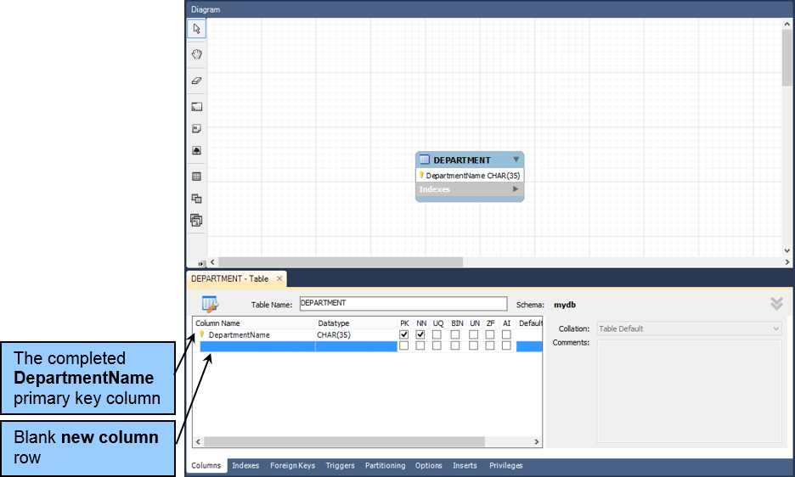
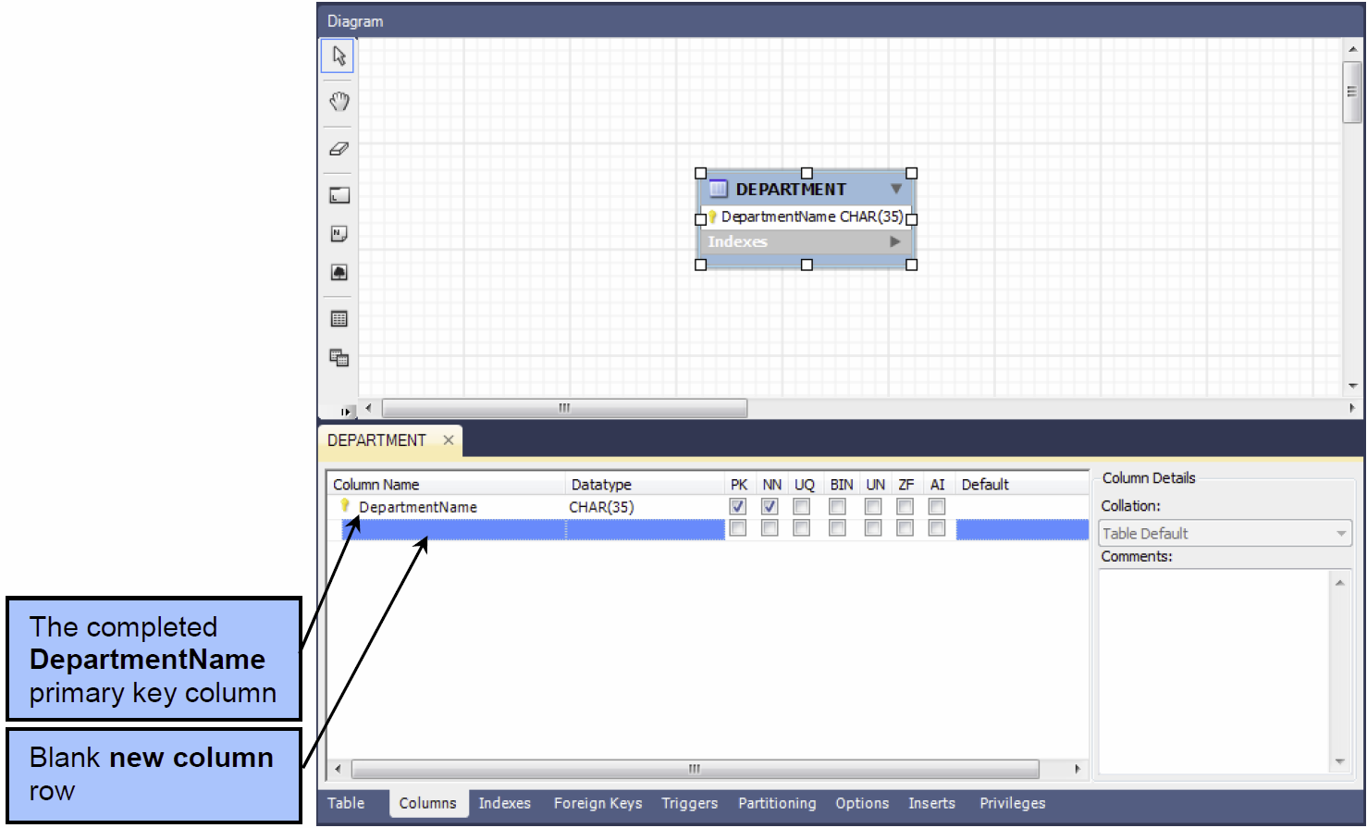
The Completed DepartmentName Primary Key Column

Slide 20
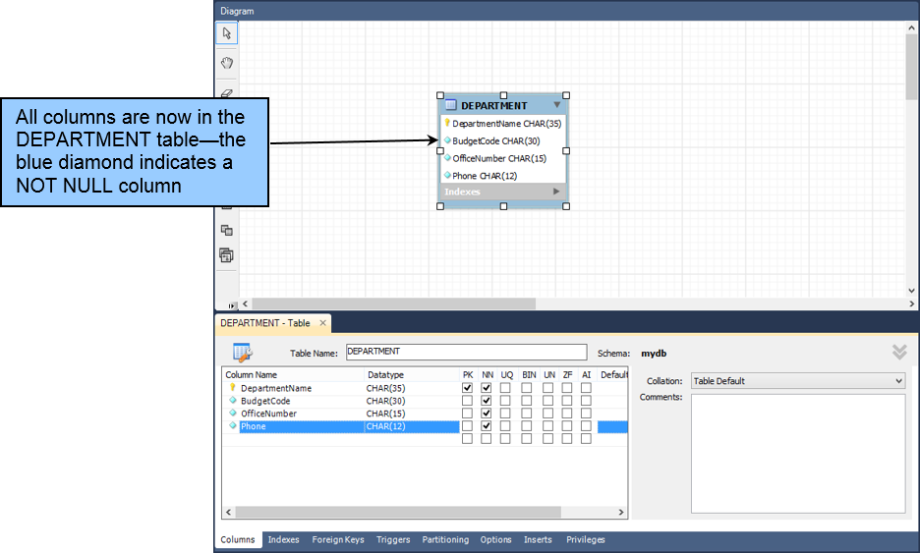
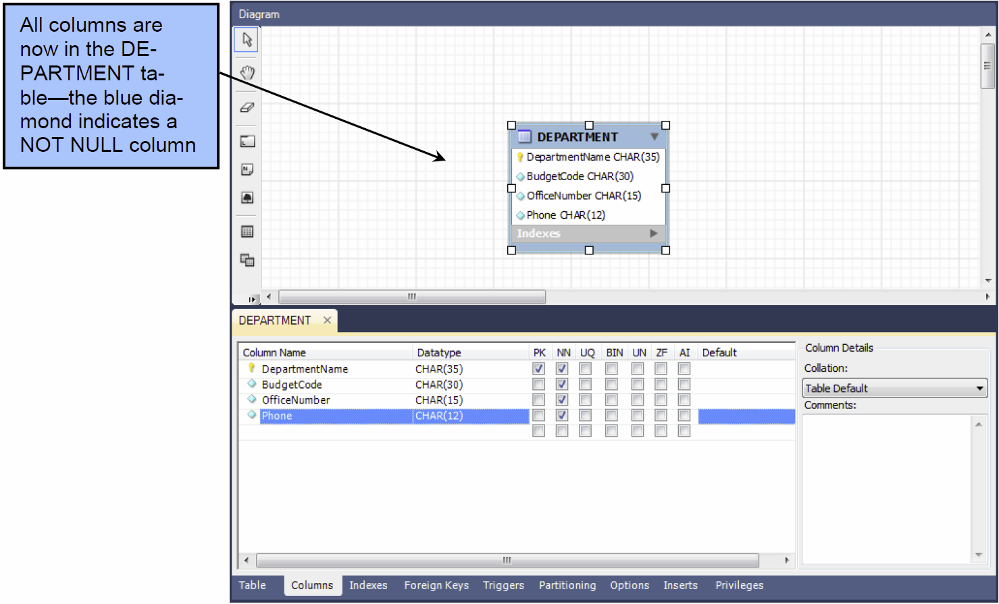
The Completed DEPARTMENT Table

Slide 21
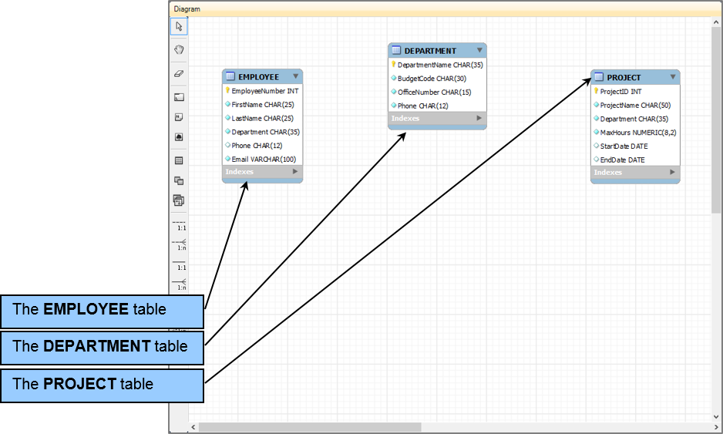
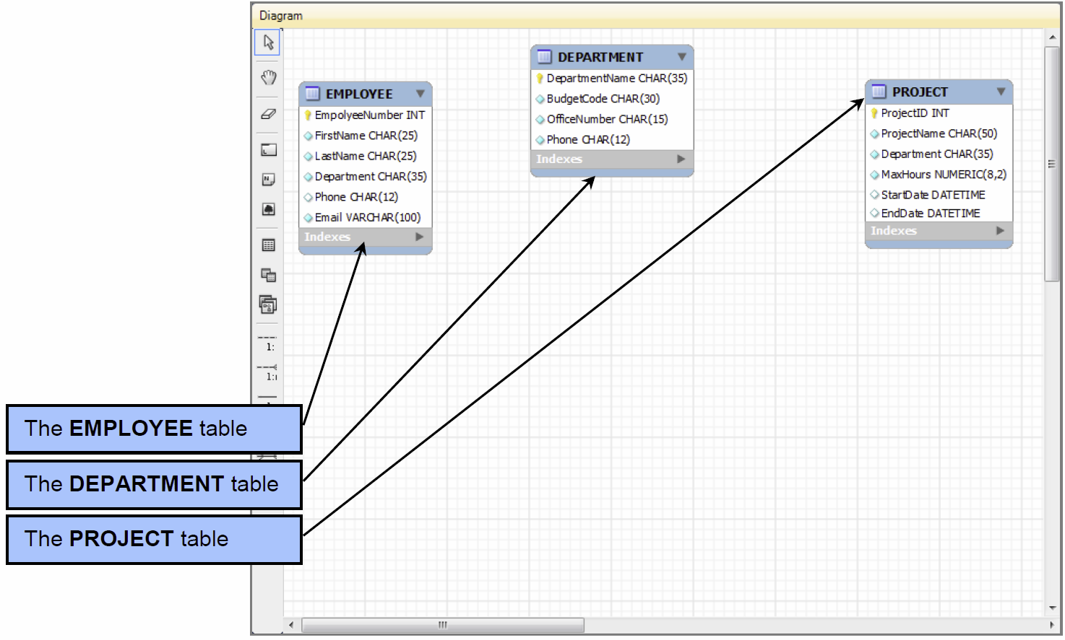
The Completed DEPARTMENT, EMPLOYEE and PROJECT Tables

Slide 22
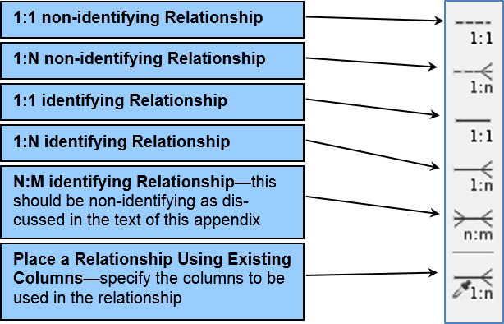
Relationships in the MySQL Workbench EER Diagram Toolbar

Slide 23
MySQL Workbench Relationship Button Options
1:1 Non-identifying Relationship—Used between two strong entities.
1:N Non-identifying Relationship—Used between two strong entities.
1:1 Identifying Relationship—Used between a strong entity and an ID-dependent weak entity—BUT an identifying relationship requires multiple children, so this does not make sense!
1:N Identifying Relationship—Used between a strong entity and an ID-dependent weak entity.
N:M Identifying Relationship— Used between a strong entity and an ID-dependent weak entity—BUT because an N:M relationship is between two strong entities, this should be non-identifying! HOWEVER, it is immediately converted to two 1:N ID-dependent identifying relationships as discussed below.
Place a Relationship Using Existing Columns—See discussion below.

Slide 24
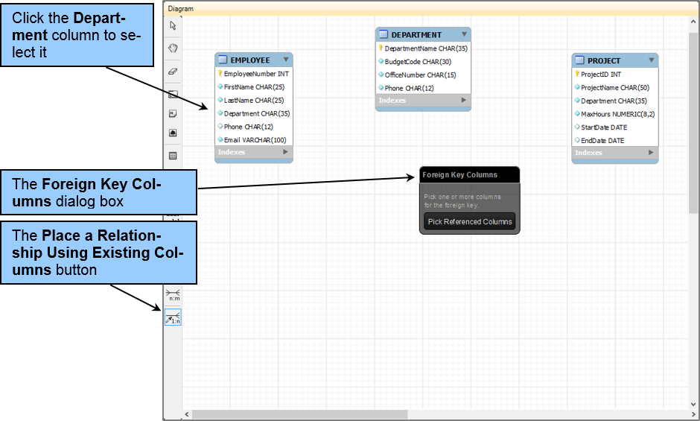
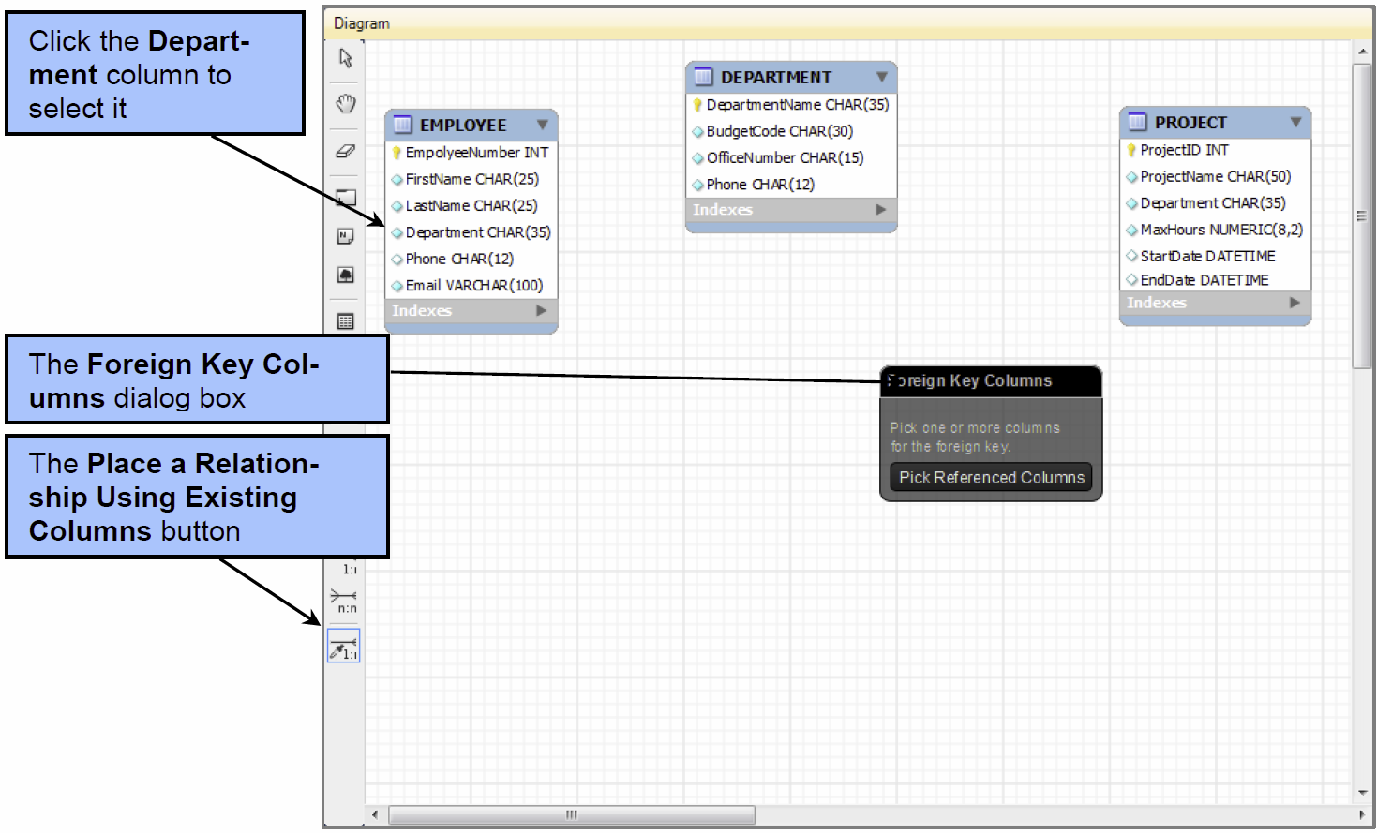
Place a Relationship Using Existing Columns The Foreign Key Columns Dialog Box – Pick Columns for Foreign Key

Slide 25
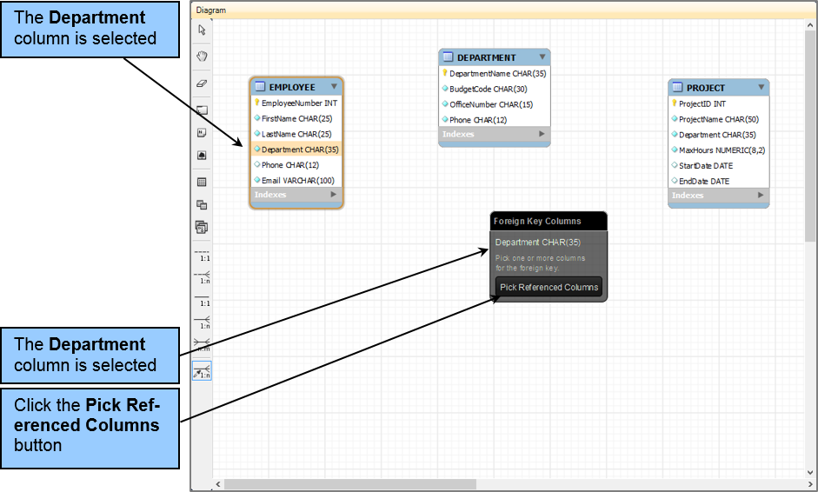
Place a Relationship Using Existing Columns EMPLOYEE.Department Selected as The Foreign Key Column

Slide 26
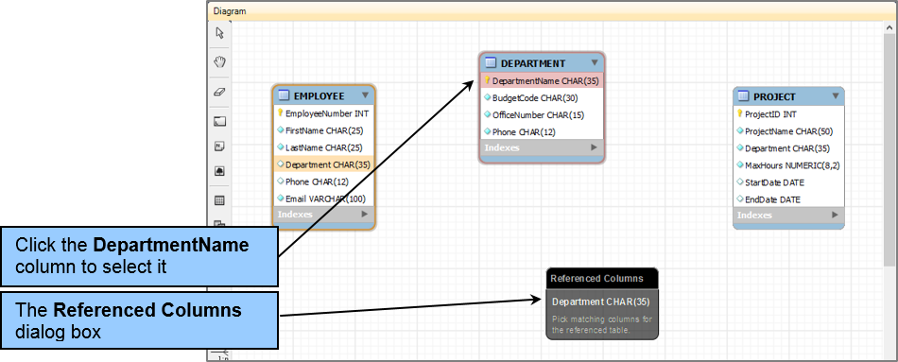
Place a Relationship Using Existing Columns The Referenced Columns Dialog Box – Pick Referenced Primary Key

Slide 27
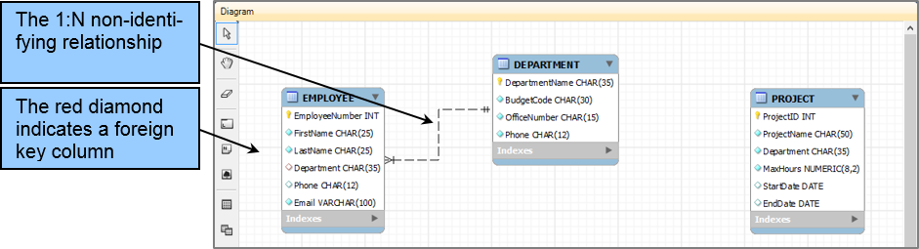
Place a Relationship Using Existing Columns The Completed 1:N Non-identifying Relationship

Slide 28
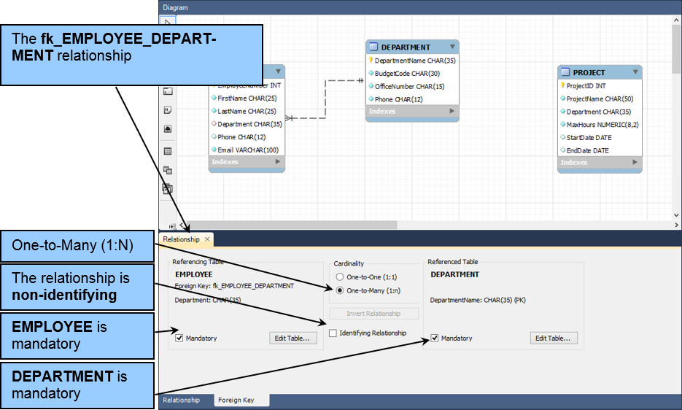
Place a Relationship Using Existing Columns The fk_EMPLOYEE_DEPARTMENT Foreign Key Properties

Slide 29
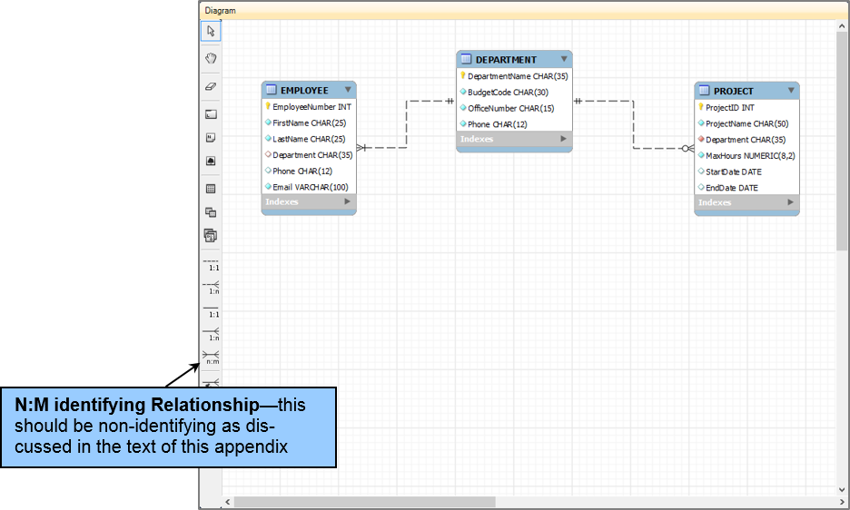
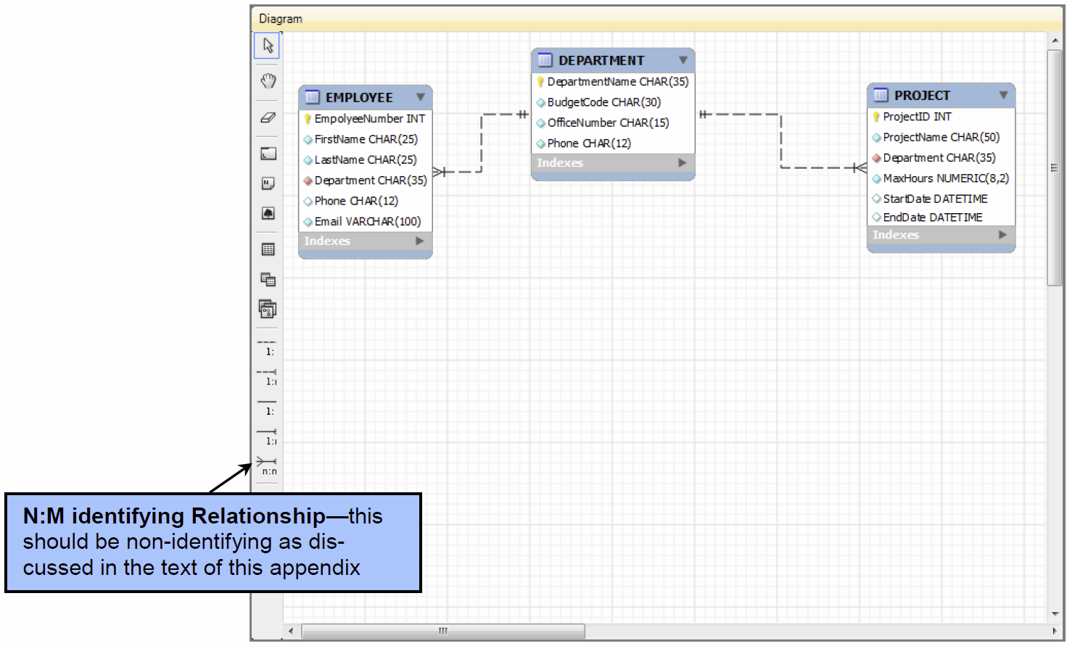
The Completed DEPARTMENT, EMPLOYEE and PROJECT Relationships

Slide 30
MySQL Workbench N:M Relationships
An N:M relationship only exists in a data model (as a non-identifying relationship between two strong entities).
In a database design, the N:M relationship becomes two 1:N ID-dependent identifying relationships linking the two original tables through a new, third table called an intersection table.
MySQL Workbench only builds database designs and automatically creates the intersection table with the two 1:N relationships whenever we specify an N:M relationship.

Slide 31
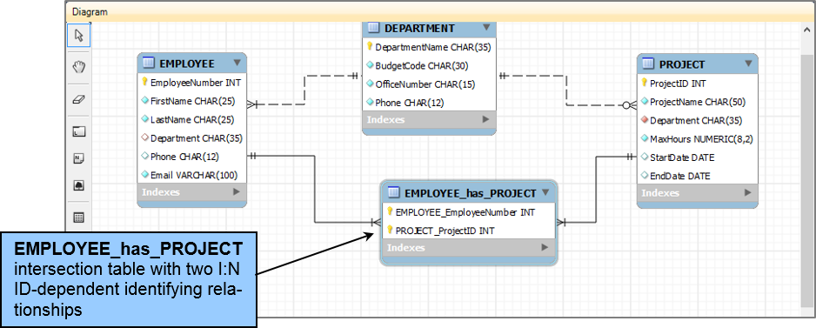
The Completed Set of Relationships

Slide 32
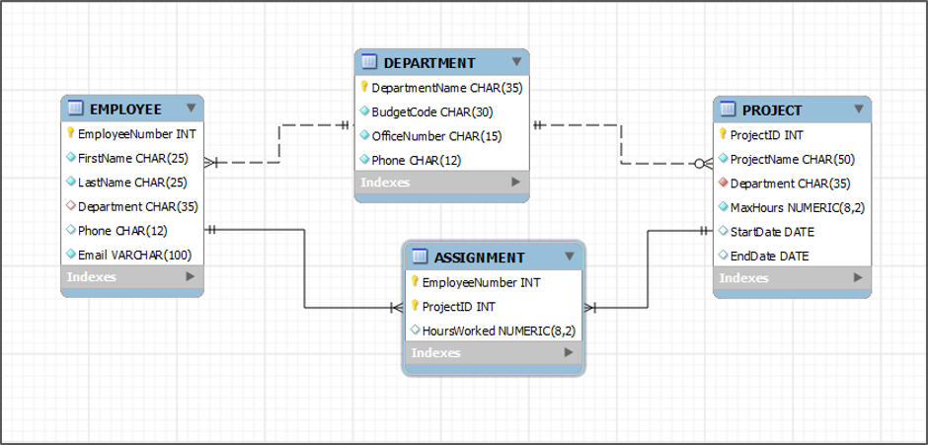
The Completed E-R Diagram

Slide 33
David Kroenke and David Auer Database Processing Fundamentals, Design, and Implementation (13th Edition)
End of Presentation:
Appendix E

Slide 34

All rights reserved. No part of this publication may be reproduced, stored in a retrieval system, or transmitted, in any form or by any means, electronic, mechanical, photocopying, recording, or otherwise, without the prior written permission of the publisher. Printed in the United States of America.

